Slide 1
Girls Who Code Teacher Training
How to Use the Curriculum
‹#›
Notes:
Facilitation notes found here, in addition to in slide notes.
https://docs.google.com/document/d/1s1IRTDYsv4_pQUzxmNIEL7uOFnTW1MdJMUjg5vF96Js/edit

Slide 2
ICEBREAKER
Introduce yourself to a partner and share:
Why are you spending 7 weeks with Girls Who Code?
Notes:
Make a point: Everyone came to be a part of closing the gender gap in tech. We’ve spent the last year doing research and refining the tools that we believe will help you do that. Today, we are going to show you how those tools are intended to do that.

Slide 3
OBJECTIVES
By the end of this session, GTWBAT:
Name the various pieces of the curriculum.
Articulate the role of the curriculum in the classroom.
Explain the overarching educational goals for SIP.
Notes:
GTWBAT = Great teachers will be able to

Slide 4

Interaction Meter
Interaction mode: You’ll be observing, participating, and leading at different times during this session. If you are ever confused what your role or task is, ask a neighbor or raise your hand.
I DO | WE DO | YOU DO

Slide 5
Teaching Move[s]
Questioning
Using questions to check for understanding. Generally these are pre-planned and range in level of prompting necessary.
Differentiation
Adapting a lesson or activity to meet the specific needs of your students
TEACHING
MOVE
Remember: when we use it, you’ll see this icon on the slide!

Slide 6
SESSION AGENDA
Icebreaker - 5 min
Goals and Agenda - 5 min
Learner Profile and Essential Understandings - 15 min
Unit Plans - 15 min
Lesson Plans - 15 min
How to Be a Superuser - 5 min
Closing - 1 min
Notes:
Total time:
60 + 80

Slide 7
Decision Making Framework
Advocate for all students
Make your thinking visible
Build more than code

Slide 8
Documents for this Session
Essential Questions - On your table
Learner Profile - On your table
Unit Plan - In your e-mail
Lesson Plan - In your e-mail

Slide 9
3 GUIDING PRINCIPLES
Teaching is hard.
We should try to make it easier!
Teachers make thousands of decisions every hour.
We need to empower you to be able to efficiently make informed choices.
Teaching is a privilege.
We are all dedicated to making the experience of these young people as great as possible.
Notes:
This is what my team kept in mind when designing these materials.
We hope that you see these principles come out in our design.

Slide 10


CURRICULUM FUNNEL
Learner Profile
and
Essential Questions
Big Picture
Unit Plans
Lesson Plans
Your
Decisions
Small Moments
Notes:
Our documents are intended to work together with the decisions you must make as a teacher help create happy classrooms. They are organized from big picture to small, and that’s how we’ll talk about them together.

Slide 11
WHERE ARE WE NOW?
Icebreaker - 5 min
Goals and Agenda - 5 min
Learner Profile and Essential Understandings - 15 min
Unit Plans - 15 min
Lesson Plans - 15 min
How to Be a Superuser - 5 min
Closing - 1 min

Slide 12
Research has shown us that equipping girls with character traits necessary to persist and emphasizing key underpinnings of CS can help us build a pipeline of powerful female engineers.
Notes:
1 min - read this to yourself.

Slide 13
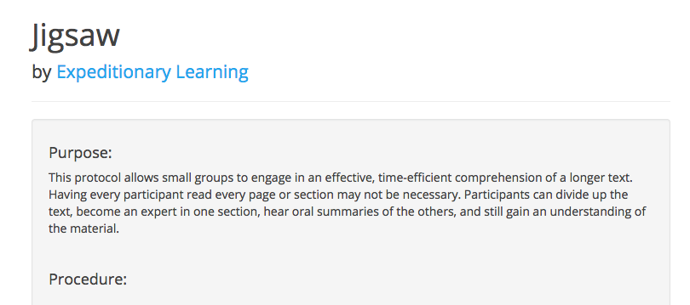
Jigsaw: Learner Profile and Essential Questions
Notes:
1 min -
We will talk more about this during our other sessions, but in each lesson we have built in various different, research based protocols to help girls interact effectively.
We have also built a website that you can use to search and read about how to implement these protocols.
We are going to use one now - the Jigsaw

Slide 14
Jigsaw: Learner Profile and Essential Questions
Instructions:
Part 1:
Read your assigned document.
As a group, discuss:
What does the document tell you?
What do you have questions about?
How might you use this with students?
How might you use this to make decisions?
Differentiation
Notes:
8 min
In part 1, you will work with a group that is all focused on the same document.

Slide 15
Jigsaw: Learner Profile and Essential Questions
Instructions:
Part 2:
When it is your turn, share:
A summary of your document.
Any highlights that you would recommend someone else read.
If there is time, discuss any lingering questions about these documents.
Notes:
8 min
In part 2, you will share what you learned with a group of people who learned other things.

Slide 16
Jigsaw: Group Debrief
Questioning
Which document outlines the content goals for the Summer Immersion Program? Character goals?
How might these documents help you make decisions in your classroom?
Notes:
5 min

Slide 17
Summary - Learner Profile and Essential Questions
Questioning
Learner Profile
and
Essential Questions
These documents summarize the big goals that we want every classroom to hit this summer.
Unit Plans
Lesson Plans
Your
Decisions
Notes:
5 min
Use these as guiding principles as you are making decisions by asking…. Will this get me closer to answering an essential question? Will this help me get the girls closer to embodying the Learner profile?

Slide 18
Where are we now? - Agenda
Icebreaker - 5 min
Goals and Agenda - 5 min
Learner Profile and Essential Understandings - 15 min
Unit Plans - 15 min
Lesson Plans - 15 min
How to Be a Superuser - 5 min
Closing - 1 min

Slide 19
Summer Immersion Program Roadmap
Unit 1: Fundamentals
2 weeks
Unit 2: Applications
2 weeks
Unit 3: Advanced Topics
1 week
Unit 4:
Final Projects
2 weeks
Scratch
Python HTML/CSS
C++
JavaScript
Python
Choose your own adventure!
Notes:
< 1 min
Pause to give them time to read.
Say: The content we are going to learn and experiment with during this session falls near the end of SIP, after girls have learned all of the rest of their content.

Slide 20
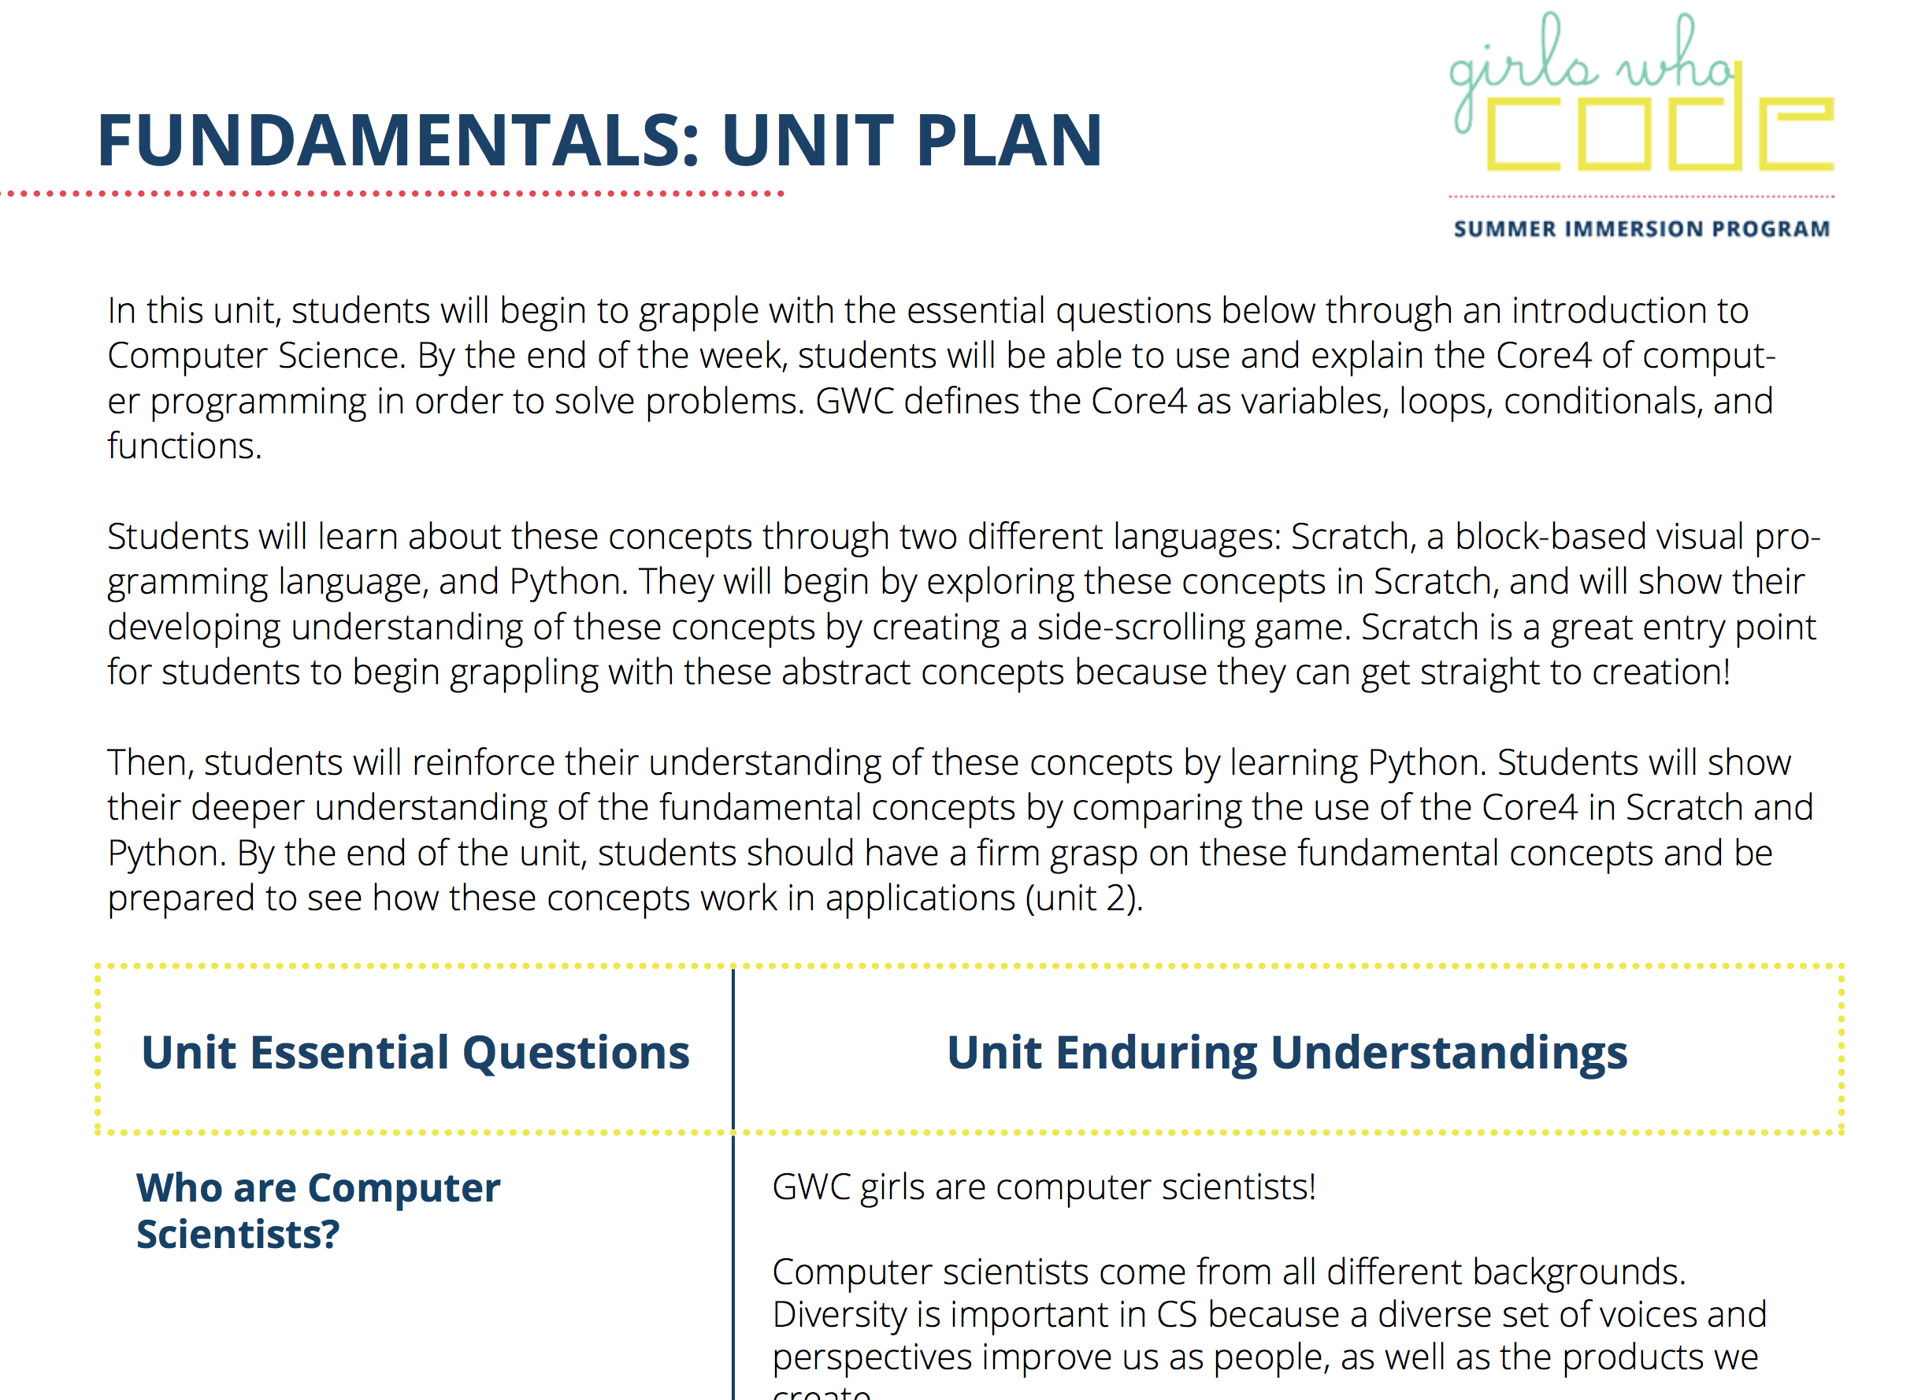
Overview: Unit Plan
Notes:
https://drive.google.com/open?id=0B4cZtWDctv5idVlid1c0N2JZRVU
Navigate to the Unit Plan and point out
Essential Questions
The overview
The calendar
The learning plan

Slide 21
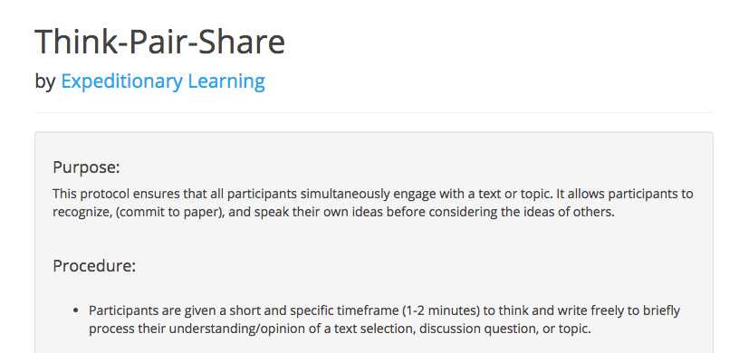
Think-Pair-Share: Unit Plans
Notes:
10 min
In part 1, you will work with a group that is all focused on the same document.

Slide 22
Think-Pair-Share: Unit Plans
Instructions:
Think: Read through the Unit Plan
Pair: With a partner, discuss:
How do you see this connecting with the Learner Profile and Essential Questions?
How might you use this when planning for your classroom?
Share: Be ready to discuss as a group!
Questioning
Notes:
Circulate as people are reading through the unit plan

Slide 23
Where are we now? - Agenda
Icebreaker - 5 min
Goals and Agenda - 5 min
Learner Profile and Essential Understandings - 15 min
Unit Plans - 15 min
Lesson Plans - 15 min
How to Be a Superuser - 5 min
Closing - 1 min

Slide 24
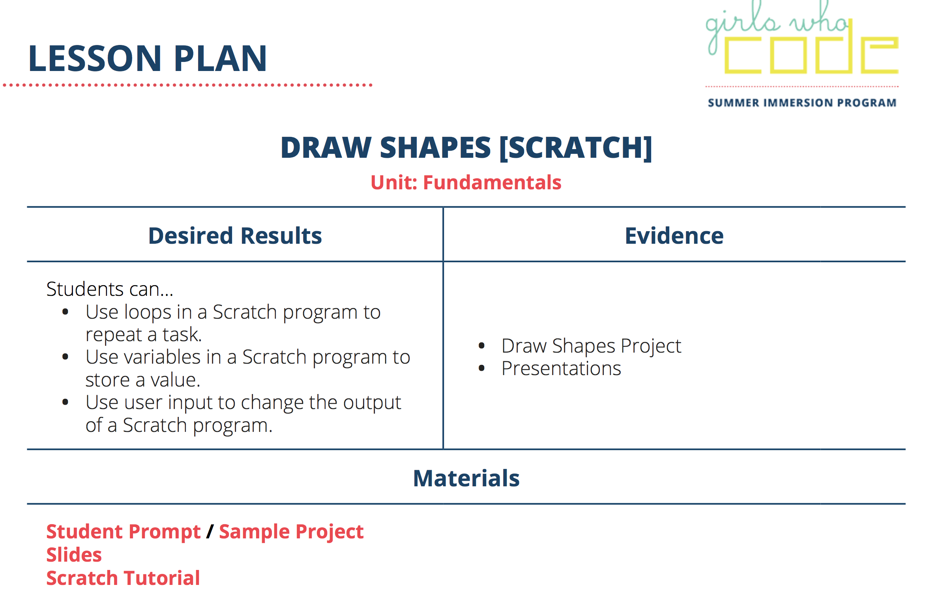
Overview: Lesson Plans
Notes:
https://docs.google.com/document/d/1_aIkoNt__xqucKCh9zfSiYEd4CViM_d8S534anMQMks/edit
https://docs.google.com/document/d/1B4CkuUjGKVm9v49X6xXovhPbieWbw5hxJDV5mBRKU_g/edit#
Navigate to the lesson plan and point out
Desired results
Agenda
Evidence
Activity plan

Slide 25
Think-Pair-Share: Lesson Plans
Instructions:
Think: Read through the Lesson Plan
Pair: With a partner, discuss:
How do you see this connecting with the Unit Plan?
How might you use this when planning for your classroom?
Share: Be ready to discuss as a whole-group!
Notes:
Circulate as people are reading through the lesson plan

Slide 26
Summary - Unit and Lesson Plans
Learner Profile
and
Essential Questions
These documents help you break the big goals into smaller, more manageable pieces.
Unit Plans
Lesson Plans
Your
Decisions
Notes:
Unit and lesson plans provide research backed structure that will help you guide your class towards your big goals. They also offer tips and suggestions on how to use your teacher power best by recommending strong and varied facilitation strategies. They don’t, however, tell you how differentiate for students who have different needs. They don’t tell you the exact words that you need to say at all times. They don’t tell you when you should or shouldn’t check for understanding. However, because they provide this structure, it frees you up to use your power in the classroom to make the best choices possible for our students.

Slide 27
Where are we now? - Agenda
Icebreaker - 5 min
Goals and Agenda - 5 min
Learner Profile and Essential Understandings - 15 min
Unit Plans - 15 min
Lesson Plans - 15 min
How to Be a Superuser - 5 min
Closing - 1 min

Slide 28


How To Be a Superuser
Document | # | Ideal Use | Why?
Learner Profile | 1 | Internalize during training, revisit with girls.
Essential Questions | 1 | Internalize during training, revisit with girls.
Unit Plan | 4 | Read them all during training and Week 0. Reread the Friday or Sunday before teaching the unit.
Daily Lesson Plans and Materials | 28 | Read through any personal “hot spots” during Week 0. Read the afternoon before teaching it, and complete the student project. Make notes on how you want to customize it, including checks for understanding, student groupings, or extra challenges.
Notes:
These are recommendations - different people plan differently.
The why is universal, though!
Learner profile and EQs are your guiding lights. The unit plan and daily lesson plans help you fit all of the pieces together.

Slide 29
Agenda
Icebreaker - 5 min
Goals and Agenda - 5 min
Learner Profile and Essential Understandings - 15 min
Unit Plans - 15 min
Lesson Plans - 15 min
How to Be a Superuser - 5 min
Closing - 1 min

Slide 30
Closing - How’d we do?
By the end of this session, GTWBT:
Name the various pieces of the curriculum.
Articulate the role of the curriculum in the classroom.
Explain the overarching educational goals for SIP.
Learner Profile
and
Essential Questions
Unit Plans
Lesson Plans
Your
Decisions

Slide 31
Next Steps
Refer to these documents over the course of the weekend to help you internalize them further.
Begin to formulate a Week 0 plan - what documents will be the most useful to you, based on how you like to get things done?

Slide 32
Training Progress
Friday | Saturday | Sunday
Classroom Mgmt | Django | Final Projects
How to Use Curriculum | OOP | SIP Simulation
Escalation Process | Diversity and Inclusion
Python |  | Training to Week 0
Robotics

